Slide 1
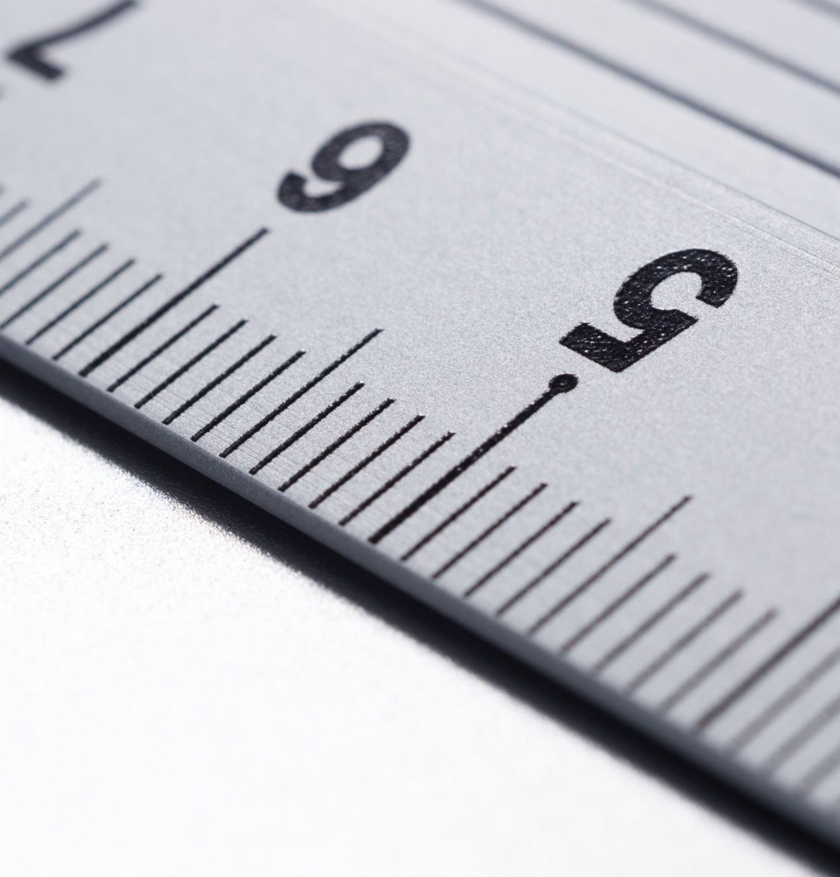
Intro to SVG Part 2: Positioning in SVG

Slide 2

Rob Larsen
Rob is an experienced front-end engineer, author and open-source contributor.
Rob is co-author of Professional jQuery, the author of Beginning HTML and CSS, the author of The Uncertain Web, from O’Reilly, the author of Mastering SVG and co-author of The HTML and CSS Workshop.
A long-time open-source contributor, Rob currently maintains HTML5-Boilerplate and administers the H5BP organization on GitHub.

Slide 3
What we’ll cover
SVG’s user coordinate system
The SVG viewport
User units
The SVG viewBox
Manipulating the viewBox

Slide 4
The SVG user coordinate system
Notes:
To move forward, let’s take a step back and look at the fundamentals of positioning SVG elements.
We talked about using x and y coordinates to position an element in an SVG document in the first video in this series.
There’s more to it than that so let’s define the svg user coordinate system in detail

Slide 5
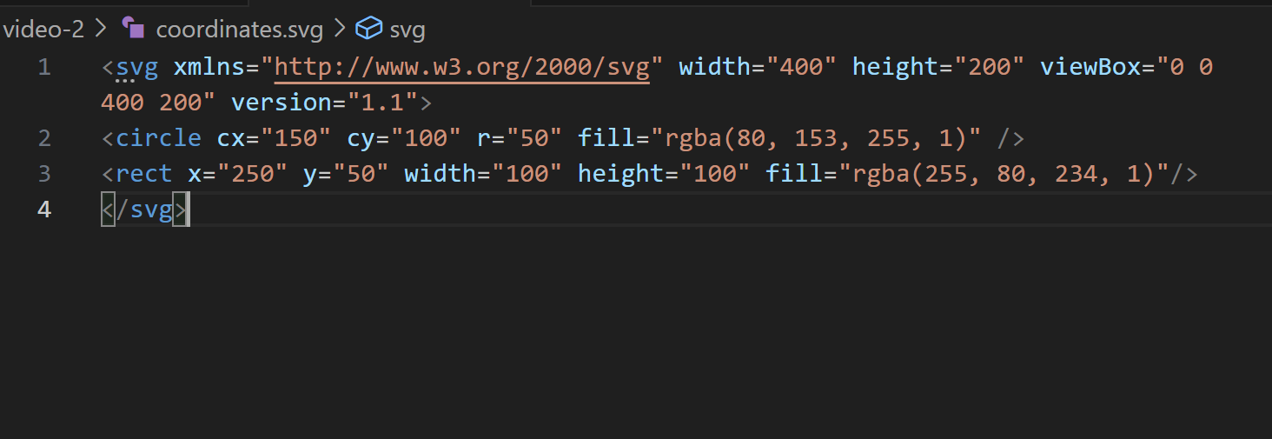
coordinates.svg
Notes:
As we learned in the first video, SVG elements use a coordinate positioning system to position elements on the screent. By default, 0,0 is the origin and is located in the the upper left-hand corner of the SVG element. The plane continues infinitely in all directions.
Elements in an SVG document are positioned using x and y coordinates relative to the origin. If you’re a web developer and you're used to working with CSS, this will be familiar to you. It’s like working with absolutely positioned elements.
The only difference in SVG is that are are two different attributes used to place elements on the plane. This example illustrates that. As you learned in the last video when we introduced the Circle element, cx (Center x) and cy (circle y) are used to define the center of a circle. In the newly introduced rect element (rectangle) the x and y coordinates define the upper left-hand corner of the element. In other words, placing a rect element is the same as absolutely positioning a div in an HTML page.

Slide 6
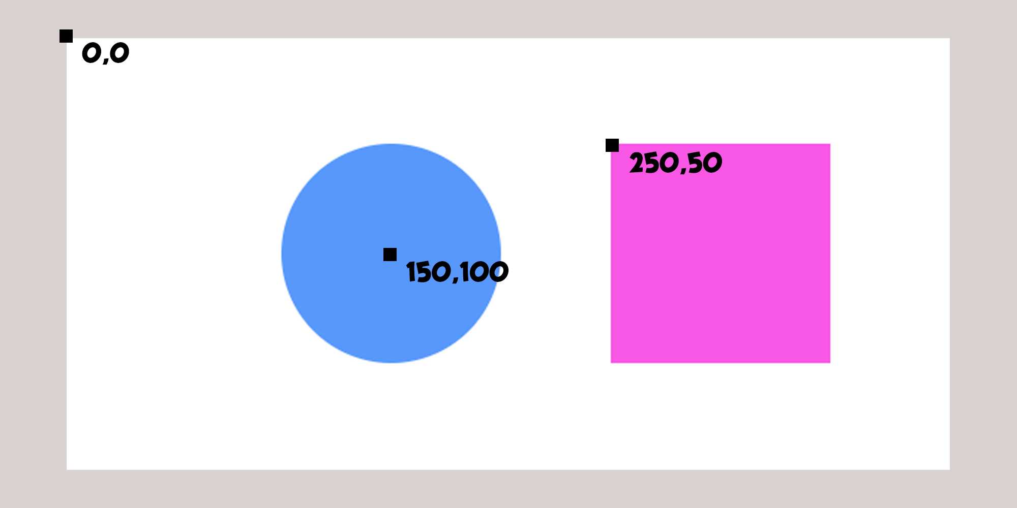
Coordinates in action
Notes:
The origin is 0,0. The center of the circle is 150,100 and the rectangle is at 250,50

Slide 7
The viewport

Slide 8
coordinates.svg
Notes:
On an svg element, the height and width attributes define the viewport of the SVG element. In this case 400 wide and 200 high.
The viewport is the visible canvas of an SVG element. As we just learned, the dimensions of the underlying SVG document can be much
larger than the viewport, but the visible area is defined by the viewport.
This is where things get interesting. If you just set the height and width attributes of an SVG element and don't use the viewBox
attribute, or, as in this case define it to correspond to a 0,0 origin and the same height and widthas the underlying image, the coordinate plane in your SVG element will behave just like CSS.
In this case of the coordinate system will start with
the coordinates (0x,0y) and will end at (400x/200y).
In this case, each user unit will default to one pixel on the screen. What’s a user unit? Let’s define it and show some examples.

Slide 9
USER UNITS

Slide 10
USER Units
In SVG, "user units" are an abstract, dimensionless unit used to calculate the position of elements in an SVG image
By default, one user unit is equivalent to one pixel
the viewBox attribute on the <svg> element can establish a separate "user coordinate system," allowing for scaling, panning, and zooming of the SVG content relative to the viewport, effectively changing what one user unit represents visually without altering the underlying numerical values.
Notes:
In SVG, "user units" are an abstract, dimensionless unit fundamental to how svg elements are rendered and scaled by the browser. By default, one user unit is equivalent to one pixel (px), meaning that any numerical value specified without a unit identifier in SVG while technically a “user unit” is actually a pixel.
While the initial coordinate system uses these user units that are the equivalent to system pixels, the viewBox attribute on the SVG element can establish a separate user coordinate system allowing for scaling, panning, and zooming of the SVG content relative to the viewport. This, effectively changes what one user unit represents visually without altering the underlying numerical values. This is very powerful

Slide 11
The ViewBox
Notes:
Let’s look at the viewbox and examples of user units in action.

Slide 12
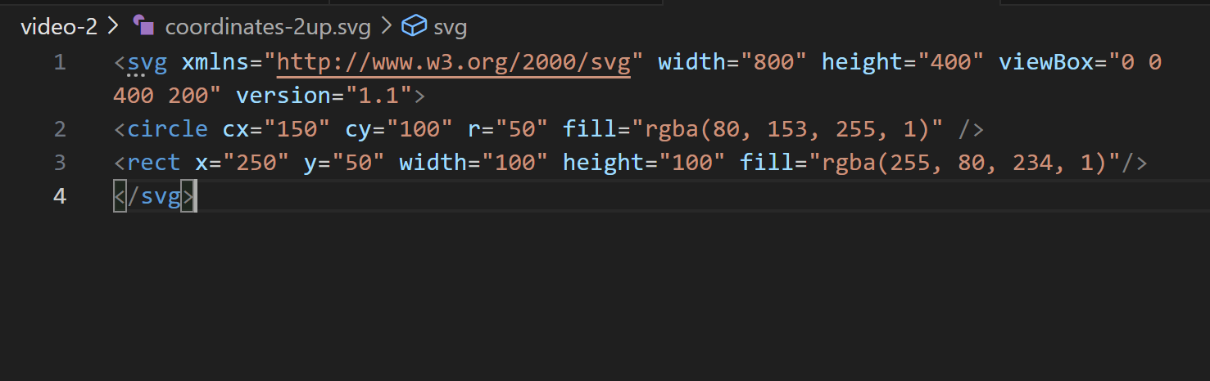
Coordinates-2up.svg
Notes:
To start to understand the way all this works, let’s ask-
What happens if you double the size of the viewport by doubling the height and width of the SVG element- changing nothing else?

Slide 13
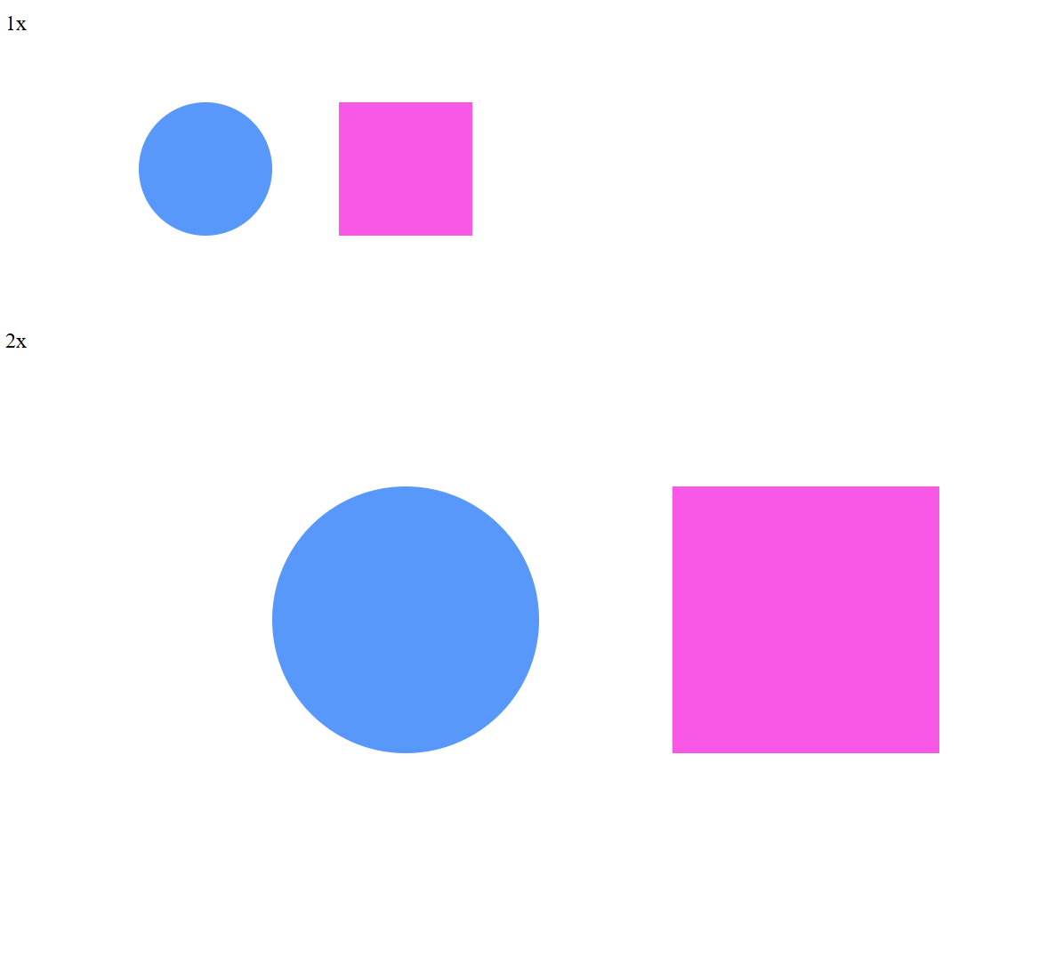
1x and 2x viewport examples
Changing nothing but the height and width scales the image. User units are no longer equivalent to 1 physical pixel, but the calculations are handled automatically by the browser.
Notes:
If you double the height and width, it doubles in viewport size to 800 x 400 pixels and the image scales accordingly. Since the viewBox and all the underlying coordinates remain the same the image scales up perfectly.
Remember, since the rendering of SVG elements happens in the browser and is calculated based on the instructions in your SVG document and not pre-defined pixles (like a JPG or PNG) this means that you can double the size of an image just by changing the height and width and it will scale up perfectly. This is one of the best things about SVG.

Slide 14
Playing with the ViewBox

Slide 15
Viewbox anatomy

Slide 16
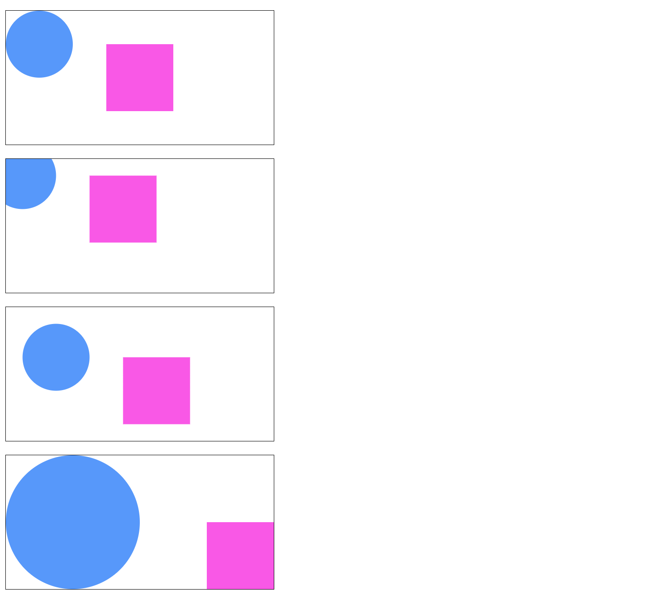
Viewbox-demo-2.html
Notes:
In this example we adjust the viewbox in three different ways.
The first image is the baseline. The origin x and y are set to 0,0 and the height and width match the SVG element’s width (400,200)
The second image offsets the image by negative 25 pixels
The third image offsets the image by a positive 25 pixels
The fourth image sets the origin to 0,0, but changes the viewbox height and width to half of the intrinsic image size (200,100)

Slide 17
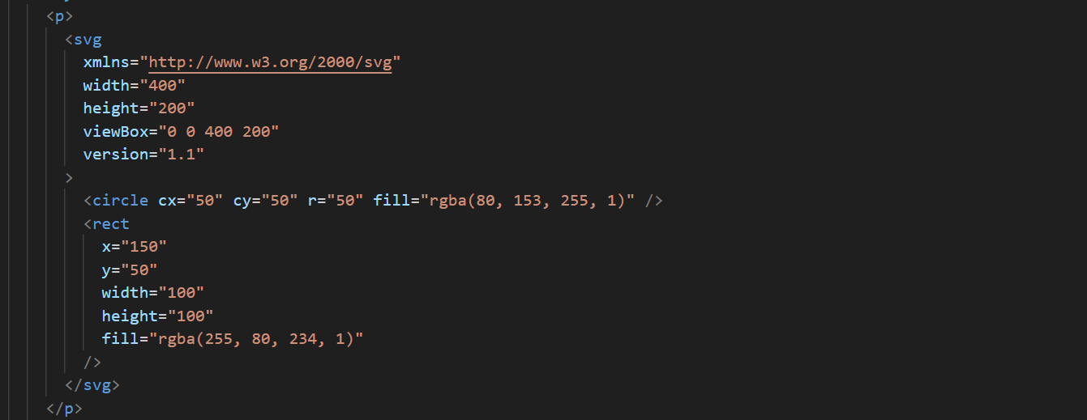
The baseline image
Notes:
This is the baseline the view box is 0 0 400 200.

Slide 18
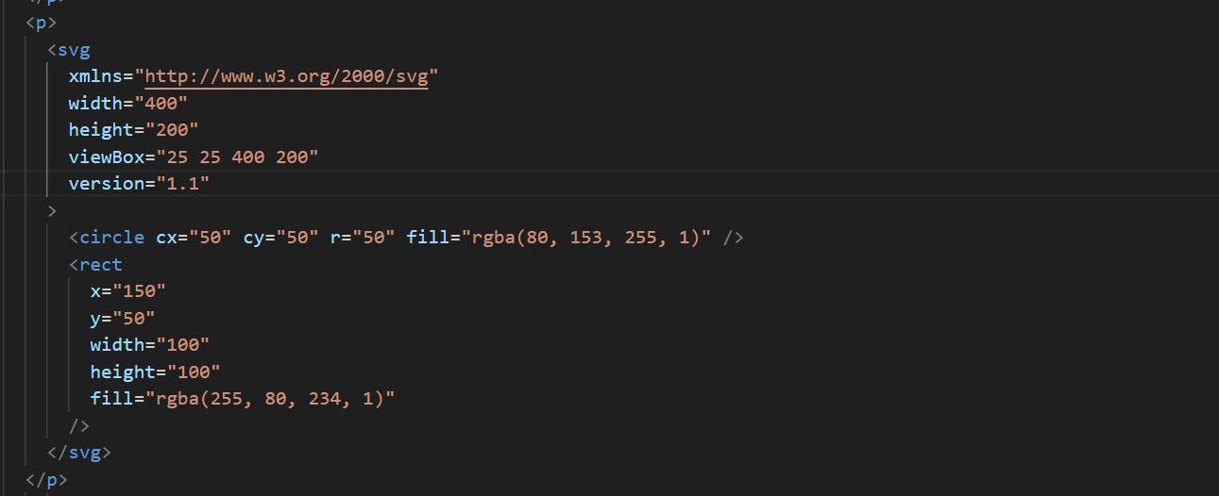
Positive 25 unit offset
Notes:
This pushes the origin up to 25x and 25y while keeping the same viewbox height and width.

Slide 19
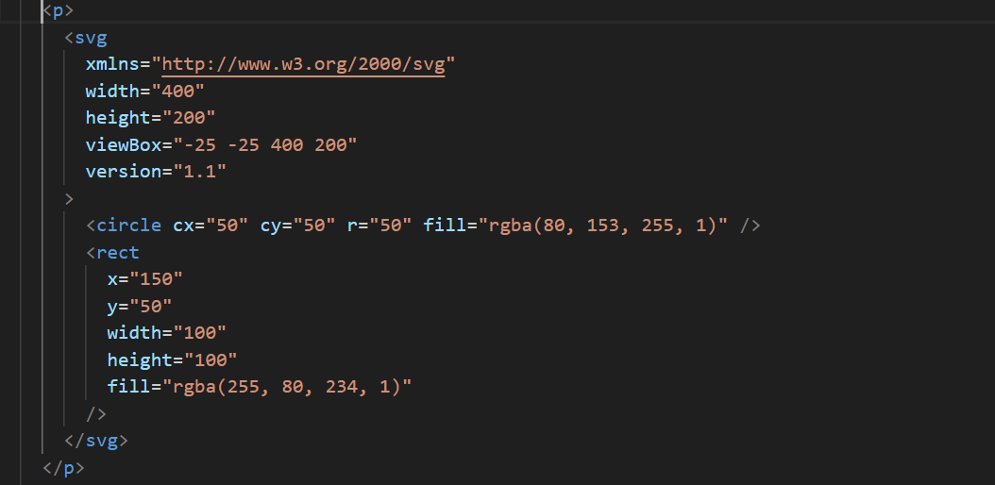
Negative 25 unit offset
Notes:
This pushes the origin back to -25x and -25y while keeping the same viewbox height and width.

Slide 20
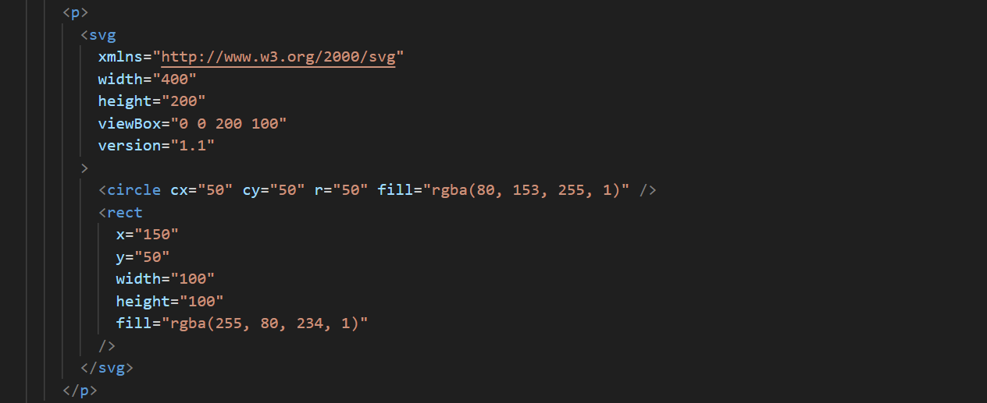
50% ViewBox height and width
Notes:
This shrinks the viewbox width by 50%

Slide 21
Viewbox-demo-2.html
Notes:
This illustrates how the changes we’ve seen change the SVG document. Remember both shapes are defined exactly the same way.

Slide 22
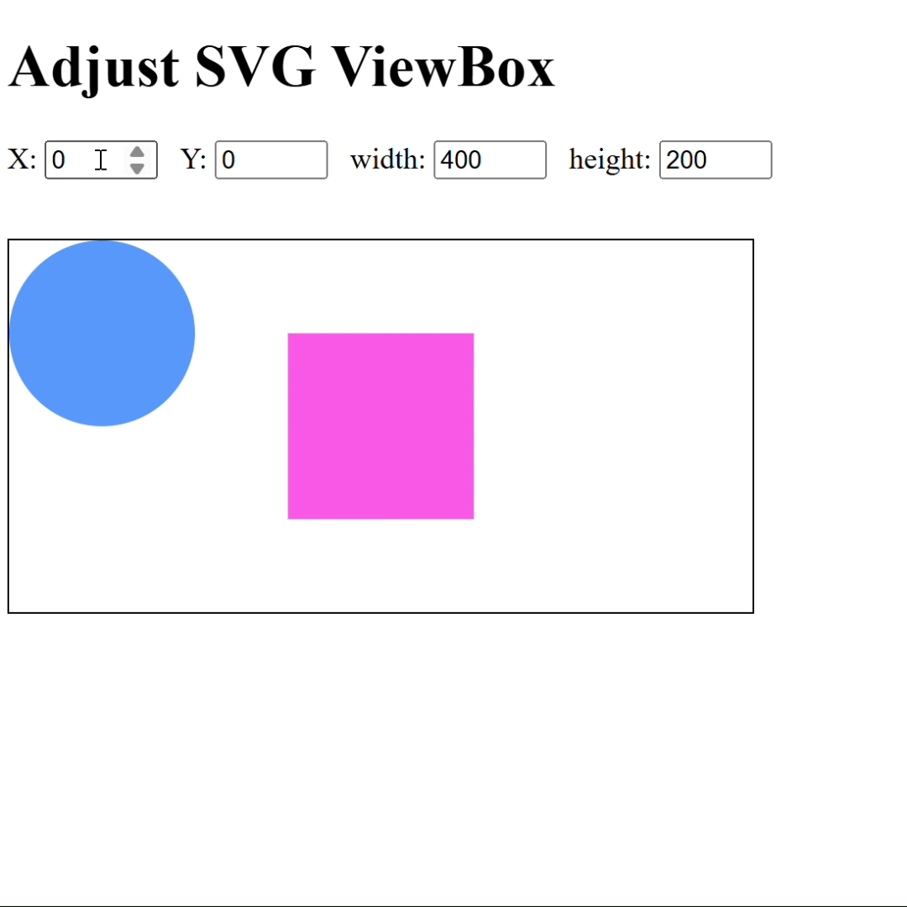
Viewbox demo
Notes:
Here’s a small demo showing how adjusting the viewbox works. In this example it can bring off-screen content onto the screen

Slide 23
What we’ve learned
Key takeaways
SVG uses a user coordinate system defined by the height and width of the image and the values of the viewBox attribute.
Adjusting the height and width and nothing else scales the image up or down perfect.
Adjusting the viewBox can pan or zoom an SVG image

Slide 24
THANK YOU
Rob Larsen
https://htmlcssjavascript.com
https://github.com/roblarsen
https://www.linkedin.com/in/robreact/
Code and slides:
https://github.com/roblarsen/introduction-to-svg

